Slide 1
INSTRUCTIONAL SLIDE – delete after reading
This PowerPoint slide deck has been developed by Cancer Council NSW.
It is intended for workplace sun safety champions. Its purpose is to used as a support tool if presenting to senior management to gain their buy in and motivation to develop a sun safety action plan in the workplace with the support of Cancer Council tools and resources.
Each slide is accompanied by suggested speaking points or instructions about where to go for more information.
Italicised blue text on slides are instructions and can be removed once read.
Please feel free to add or remove slides to suit your presentation. Some slides are supported by references. Full details of these references can be found at the end of the slide deck.
If you have any questions regarding this slide deck please contact Cancer Council NSW on sunsmart@nswcc.org.au or 02 9334 1761.
Notes:
For more information, tools and resources, visit www.cancercouncil.com.au/sun-safe-workplace

Slide 2
SunSmart Workplaces
A business case for action
Notes:
For the user:
This PowerPoint slide deck has been developed by Cancer Council NSW.
It is intended for workplace sun safety champions. Its purpose is to used as a support tool if presenting to senior management to gain their buy in and motivation to develop a sun safety action plan in the workplace with the support of Cancer Council NSW tools and resources.
Each slide is accompanied by suggested speaking points.
Italicised blue text on slides are instructions and can be removed once read.
Please feel free to add or remove slides to suit your presentation. However, we request that where slides are used content is not changed.
Some slides supported by references. Full details of these references can be found at the end of the slide deck.
If you have any questions regarding this slide deck please contact Cancer Council NSW on sunsmart@nswcc.org.au or 02 9334 1761. For more tools and resources, visit www.cancercouncil.com.au/sunsmart-workplaces

Slide 4
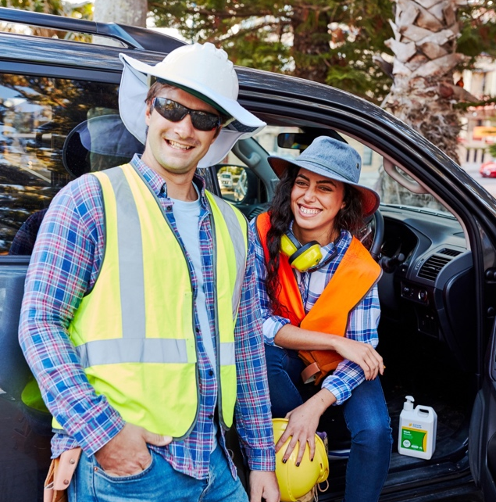
Presentation overview.
Why sun safety at work matters
The business case for action
How leadership can make a difference
Notes:
Today’s presentation will cover:
Why sun safety at work matters
The business case for action
How leadership can make a difference

Slide 5
Why sun safety at work matters
Notes:
Let’s start by exploring the scale of the issue of skin cancer in Australia and how this serious health risk applies to our workplace.

Slide 6
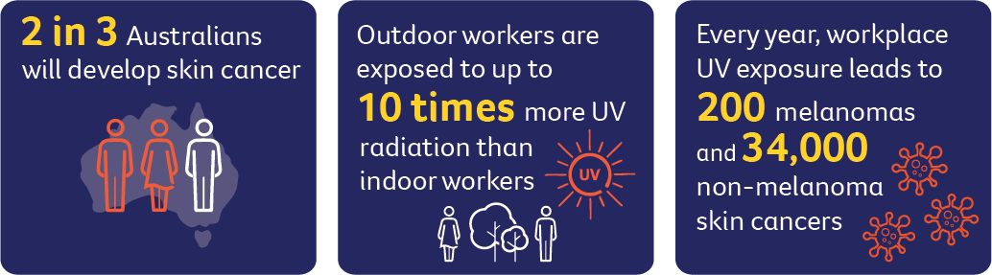
The issue we can’t ignore.
Notes:
Australia is the skin cancer capital of the world.
It is our most common cancer, with 2 in 3 Australians being diagnosed with some form of skin cancer.
Every year, workplace UV exposure leads to 200 melanomas and 34,000 non-melanoma skin cancers.

Slide 7
Our risk and duty of care.
The facts:
UV exposure is a workplace hazard that requires a health and safety response by law.
By ignoring the health risks to our staff, we are liable for costly compensation claims.
As an employer, there are things we can and should do to prevent exposure to UV.
Protecting workers from UV exposure isn’t optional, it’s an essential part of a safe workplace.
Notes:
Relevant resources
www.cancercouncil.com.au/sunsmart-workplaces https://www.sunsmart.com.au/downloads/resources/booklets/skin-cancer-outdoor-work-employer-booklet.pdf

Slide 8
Case study – legal implications
Municipal Council v Manning NSWPICPD - August 2022
A worker who had been employed for 33 years doing outdoor work (such as mowing lawns and maintaining parks) developed a serious form of skin cancer. He claimed this was caused or worsened by long-term sun exposure during his job. He took the case to the Workers Compensation Commission, asking for weekly payments starting from May 2019. The Commission agreed that his outdoor work exposed him to harmful UV rays, which accelerated his skin damage. They ruled this was a work-related injury and ordered compensation. The employer challenged the decision, but the judge ultimately dismissed the appeal, finding: • The injury was correctly classified as a disease worsened by work. • The worker’s job was the main reason for the skin damage. • The original decision was well-reasoned and based on solid medical evidence.
Notes:
This case study demonstrates the real risk to businesses such as ours if we do not put controls in place to protect staff from UV exposure.

Slide 9
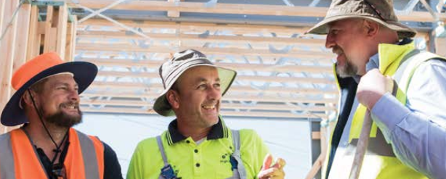
Compensation – national data
Between 2008 and 2022, almost 1,700 workers in Australia had workers’ compensation claims accepted for skin cancer.
Over that time, these claims cost more than $63 million in total. Skin cancer made up almost two in every five cancer‑related workers’ compensation claims and accounted for more than one in ten dollars spent on all cancer‑related workers’ compensation costs.
Successful skin cancer compensation claims: Show that the employer could have prevented the skin cancer injury from occurring had they implemented the necessary controls measures.
Notes:
To add to that, legal case for skin cancer compensation is becoming increasingly recognised.
According to recent Safe Work Australia between 2008 and 2022, almost 1,700 workers in Australia had workers’ compensation claims accepted for skin cancer.
Over that time, these claims cost more than $63 million in total. Skin cancer made up almost two in every five cancer‑related workers’ compensation claims and accounted for more than one in ten dollars spent on all cancer‑related workers’ compensation costs.
Click
Where skin cancer compensation claims have been successful, they have shown that the employer could have prevented the skin cancer injury from occurring had they shown they had implemented the necessary control measures.
References
Hamer, A., Ray, T., Norden, A., Stephenson, E., & King, E. (2025). Sun safety and outdoor workers: Review of the literature on intervention effectiveness (Outdoor Worker Literature Review). Cancer Council NSW. https://www.cancercouncil.com.au/wp-content/uploads/2025/11/Outdoor-Worker-Literature-Review-FINAL.pdf

Slide 10
The business case for action
Notes:
By becoming a more sun safe workplace, there are financial, legal, cultural and reputational benefits to our business. This is not only the right thing to do, but it’s also a smart decision for our business.

Slide 11
The benefits of taking action.
The good news is that skin cancer is one of the most preventable cancers.
If we take action now, we can:
Reduce the risk of legal action against our business/organisation.
Avoid our staff experiencing UV related health issues that impact their life (e.g. eye damage, heat exhaustion and dehydration)
Ensure our workers know that their workplace takes their health seriously, so they are part of a positive workplace culture.
A strong UV protection record can differentiate our workplace in audits, awards, and recruitment for a reputational lift.
Notes:
While the risk of skin cancer is very serious, the good news is that is the most preventable type of cancer. But there area also other benefits for you and your workplace is you take preventative measures.

Slide 12
Our outdoor workers.
Outdoor workers include anyone in our workplace (volunteers or staff) who find themselves undertaking activities outside:
Insert list of key workers/teams impacted by UV
‘The risk of exposure to solar UV radiation may not be obvious for some workers, for example vehicle drivers like taxi, bus, truck, delivery and courier services. Certain workers like physical education teachers may be in and out of the sun during the day so exposure may be intermittent. The accumulated exposure creates a risk to their health and safety.’ — Stephanie Creagh, Director Safe Work Australia, 2018
Notes:
Instruction: adapt this slide to tailor the list to your organisation. Consider who might find themselves working outside during their daily tasks and where controls would need to be put in place.

Slide 13
Current state of play.
This slide has been left blank.
You may like to add a summary of sun safety controls your workplace is implementing, any known history of claims and what can be built upon.
See notes on this slide for more ideas.
Notes:
You may like to add a summary of sun safety controls your workplace is implementing, and what can be built upon.
Consider taking the online workplace assessment to better understand your current state of play.
Relevant resources
Workplace assessment tool www.cancercouncil.com.au/sunsmart-workplaces
Hierarchy of control www.cancercouncil.com.au/sunsmart-workplaces

Slide 14
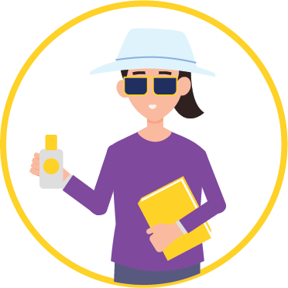
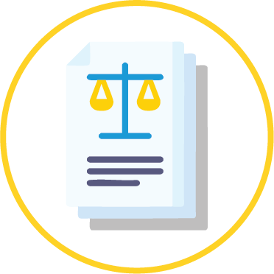



Effective sun safe programs.
An effective sun safe program at work needs to include these five things:
Leadership
Sun safety policy
Practical actions for both employers and employees
Education and training
Ongoing commitment
Notes:
There are five key elements that will support an effective sun safe workplace.
Leadership Leadership buy-in is essential because commitment from decision-makers sets the tone for a safe workplace culture and ensures sun safety is treated as a genuine organisational priority, not an optional extra. When leaders champion UV protection, workers are more likely to engage in safe behaviours, and meaningful, lasting change becomes possible. Policy A sun safety policy clearly sets out expectations and responsibilities for employers and individuals. Action for employers and employees Policies needs to be supported by meaningful action. An action plan will be critical for implementation of sun safe protections. Workplaces may want to consider scheduling, shade infrastructure and the provision of appropriate PPE, while workers should take responsibility for applying sunscreen, wearing protective clothing and seeking shade where possible. Education and training We need to ensure our workers are aware of the risks and understand what they can do to avoid or limit UV exposure. Ongoing commitment and consultation Our action plan should be regularly reviewed to ensure measures are effective and stay on the agenda. Feedback from workers should also be included in development of the action plan and any review processes, to support continuous improvement and genuine change.
References
Cancer Council Victoria. (2025). Skin cancer and outdoor work: A work health and safety guide (Updated April 2025). National Skin Committee; SunSmart. https://www.sunsmart.com.au/downloads/resources/booklets/skin-cancer-outdoor-work-employer-booklet.pdf

Slide 15
Gaps and opportunities.
At the moment, there is an opportunity for our workplace to improve in the following areas:
Leadership:
Add actions or initiatives relevant to this pillar
Policy:
Add actions or initiatives relevant to this pillar
Practical actions for both employers and employees:
Add actions or initiatives relevant to this pillar
Education and training:
Add actions or initiatives relevant to this pillar
Ongoing commitment:
Add actions or initiatives relevant to this pillar
Notes:
Instruction: consider where they key gaps are in your business. You may need to insert more slides depending on where you are in your sun safe journey.
Relevant resources
Workplace assessment tool www.cancercouncil.com.au/sun-safe-workplace
Action plan template www.cancercouncil.com.au/sun-safe-workplace
Hierarchy of controls www.cancercouncil.com.au/sun-safe-workplace

Slide 16
What role you can play as a leader.

Slide 17
How leadership can make a difference.
To support you can:
Insert list of action for decision-makers to do in order to support, enable or champion sun protection e.g.
Announce your commitment to sun safety
Appoint a sun safety officer
Profile staff who take sun safety seriously in their jobs
Lead by example: wear a hat, sunglasses, sunscreen and protective clothing while in the sun.
The journey to becoming a more sun safe workplace does not have to be costly but it does need to be achievable and sustainable.
Showing leadership is a big part of this.
Notes:
Instruction: consider how decision-makers in your business can support or enable a more sun safe workplace. You may require resourcing (time or money) or want to pitch a particular initiative in your workplace. Adapt this slide as required and add more slides as needed.
Are there any relevant resources to add here

Slide 18
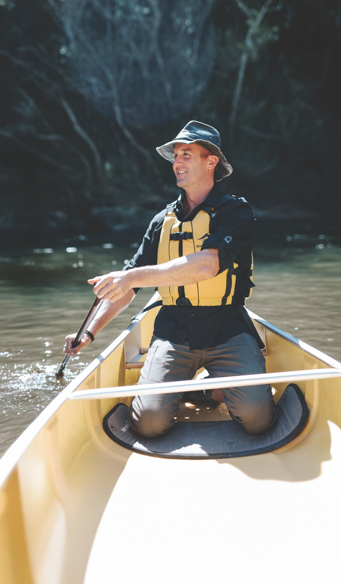
Next steps.
Insert any required next steps to implement a change or make an improvement in your workplace. You may want to start a working group or seek formal approval for a project.

Slide 19
Cancer Council is here to help
Notes:
Drawing on these insights, Cancer Council is offering complimentary support to bring about effective change in our workplace sun safety culture. Visit the Sun Safe Workplace Toolkit to access tips, tools and resources to support your sun safe journey.
Sun Safe Workplace Toolkit www.cancercouncil.com.au/sunsmart-workplaces including (UV Risk Assessment, Action Plan, Policy template, communication tools, videos and training).

Slide 20

Resources.
Comprehensive 32-page WH&S guide
SunSmart Workplaces toolkit including:
Tools to get decision makers on board
UV risk assessment
Policy template
Action plan
Communication tools
Education and training resources (videos for workers)
Notes:
There are a number of free and simple resources available to support our workplace become more sun safe
Comprehensive 32-page WHS guide https://www.cancercouncil.com.au/wp-content/uploads/2025/07/2025-AP1790-Cancer-Council-Outdoor-Workers-Guide-1.pdf
Sun Safe Workplace Toolkit www.cancercouncil.com.au/sunsmart-workplaces including (UV Risk Assessment, Action Plan, Policy template, communication tools, videos and training).

Slide 21
References.
Gies P, Wright J. Measured solar ultraviolet radiation exposures of outdoor workers in Queensland in the building and construction industry. Photochemistry and Photobiology. 2003;78(4):342-8.
Carey RN, Glass DC, Peters S, Reid A, Benke G, Driscoll TR, et al. Occupational exposure to solar radiation in Australia: who is exposed and what protection do they use? Australian and New Zealand Journal of Public Health. 2014;38(1):54-9.
SafeWork Australia. National hazard exposure worker surveillance (NHEWS) survey: 2008 results. Canberra: Safe Work Australia; 2009. 279 p. Available from: https://www.safeworkaustralia.gov.au/system/files/documents/1702/nationalhazardexposureworkersurveillancenhewssurveyresults_2008_pdf.pdf.
Social Research Centre. 2019 Cancer prevention community survey. Melbourne: The Social Research Centre; 2019. 117 p.
Cancer Institute NSW. Sun protection attitudes, intentions and behaviours of NSW males aged 40–65 years. Sydney: Cancer Institute NSW; 2019. 47 p. Available from: https://www.cancer.nsw.gov.au/getattachment/how-we-help/reports-and-publications/sun-protection-attitudes-intentions-and-behaviour/Sun-Protection-Behaviours-with-Men-Aged-40-65-Years-presentation.PDF?lang=en-AU.
Safe Work Australia. National Data Set for Compensation-based Statistics (NDS). Canberra Australia; 2022Safe Work Australia. Workplace compensation data. Canberra, Australia: National Data Team, Safe Work Australia; 2014. Safe Work Australia. Workplace compensation data. Canberra, Australia: National Data Team, Safe Work Australia; 2014.

Slide 22
References.
SafeWork NSW. Ultra-violet radiation [Internet]. [Place unknown]: SafeWork NSW; [Date unknown] [cited 2020 Jul 06]. Available from: https://www.safework.nsw.gov.au/hazards-a-z/working-in-extreme-heat/content-page-blocks/ultra-violet-radiation-uvr.
Cancer Council Western Australia. Workers’ compensation claims paid in Australia 2000-2009. Perth: Cancer Council Western Australia; 2011. 21 p. Available from: https://www.cancerwa.asn.au/resources/2011-12-05-ccupational-exposure-to-ultraviolet-radiation.pdf.
Makin J, Shaw K, Winzenberg T. Evidence check – targeted programs for skin cancer prevention: an evidence check rapid review brokered by the Sax Institute (www.saxinstitute.org.au) for the Cancer Institute NSW. Sydney; 2018. 381 p.
Queensland University of Technology. QUT outdoor worker sun protection project. Herston: Queensland University of Technology; 2013. 659 p.
Andersen PA, Buller DB, Walkosz BJ, Scott MD, Kane IL, Cutter GR, et al. Expanding occupational sun safety to an outdoor recreation industry: a translational study of the Go Sun Smart program. Translational Behavioral Medicine. 2012;2(1):10-8.
Buller DB, Walkosz BJ, Buller MK, Wallis A, Andersen PA, Scott MD, et al. Results of a Randomized Trial on an Intervention Promoting Adoption of Occupational Sun Protection Policies. American Journal of Health Promotion. 2018;32(4):1042-53.
Haynes E, Kramer DM, Strahlendorf P, Holnessc DL, Kushnera R, Tenkate T. A cross-Canada knowledge transfer and exchange workplace intervention targeting the adoption of sun safety programs and practices: sun safety at work Canada. Safety Science. 2018;102:238-50.

Slide 23
Cancer Council
Call 13 11 20
Visit
www.cancercouncil.com.au/sunsmart-workplaces

